Slide 1
DATA STRUCTURES & KEY CONCEPTS
Primary keys, normalization, structured vs unstructured data lists

Slide 2
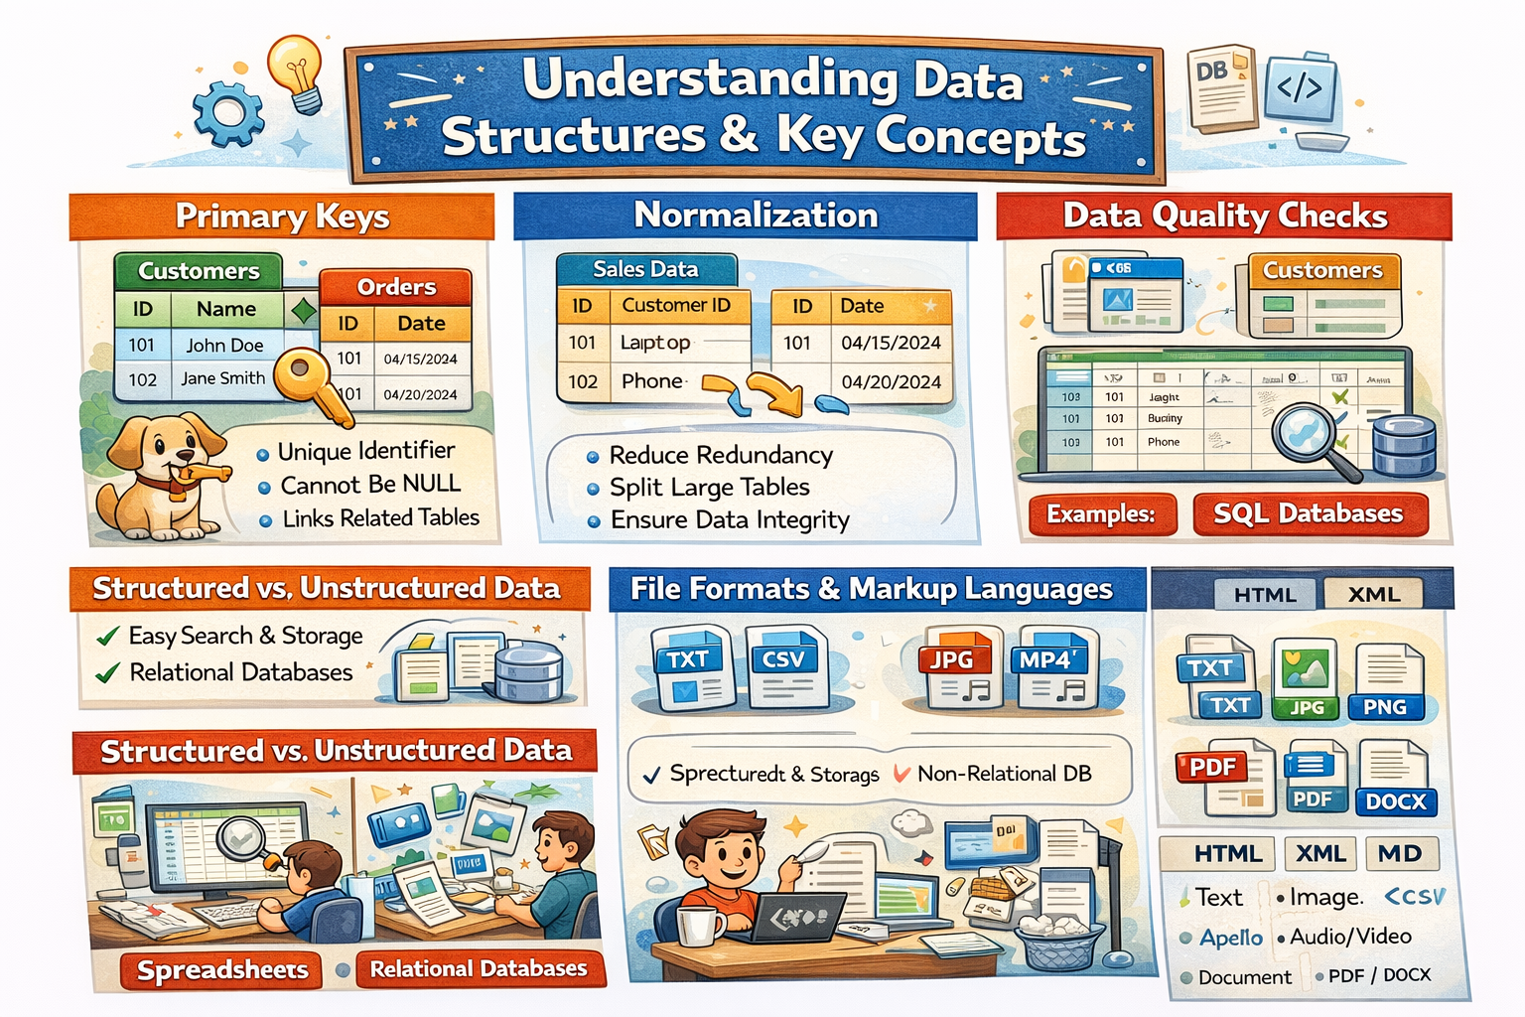

Slide 3
PRIMARY KEYS
Uniquely identifies each record in a table.
Cannot have NULL values.
Used to establish relationships between tables.
Notes:
A primary key is a unique identifier for a record within a database table.
It ensures that each record can be uniquely identified, which prevents duplicate entries.
Uniqueness: Every value in a primary key column must be unique. No two rows in the table can have the same primary key value.
Non-null: A primary key value cannot be null. Every record must have a valid primary key value.
Immutable: Once assigned, the primary key should never change. This ensures the integrity of relationships between tables in a relational database.

Slide 4
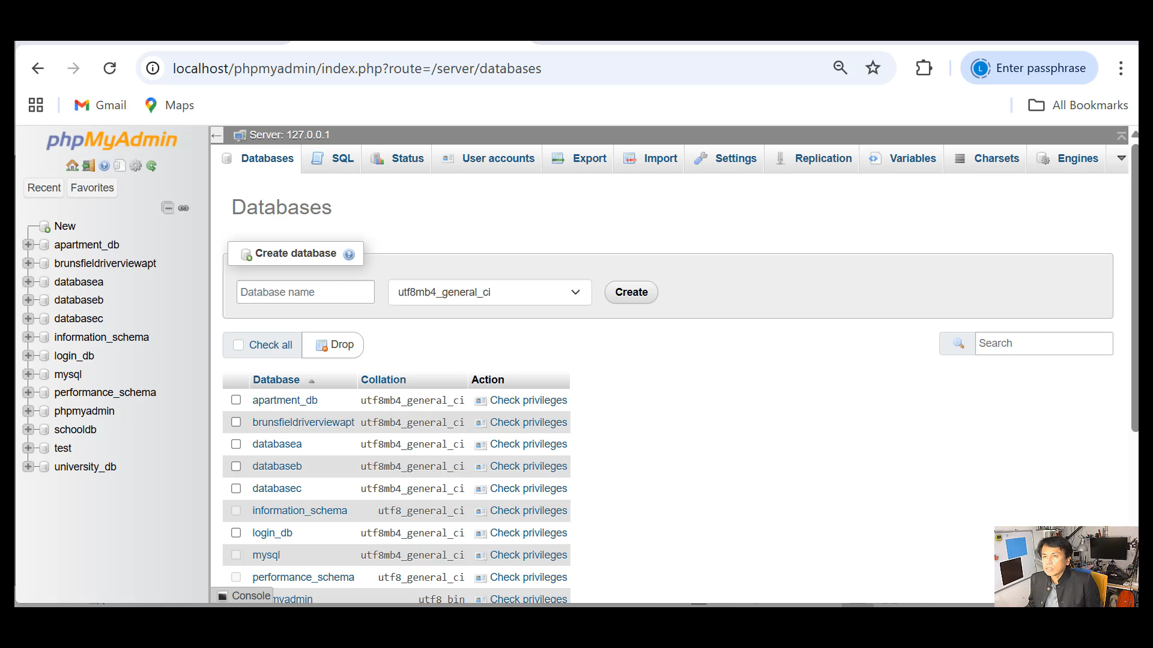
DEMO: PRIMARY KEY

Slide 5
NORMALIZATION
Process of organizing data to reduce redundancy.
Aims to split large tables into smaller ones.
Ensures data integrity and prevents anomalies.

Slide 6
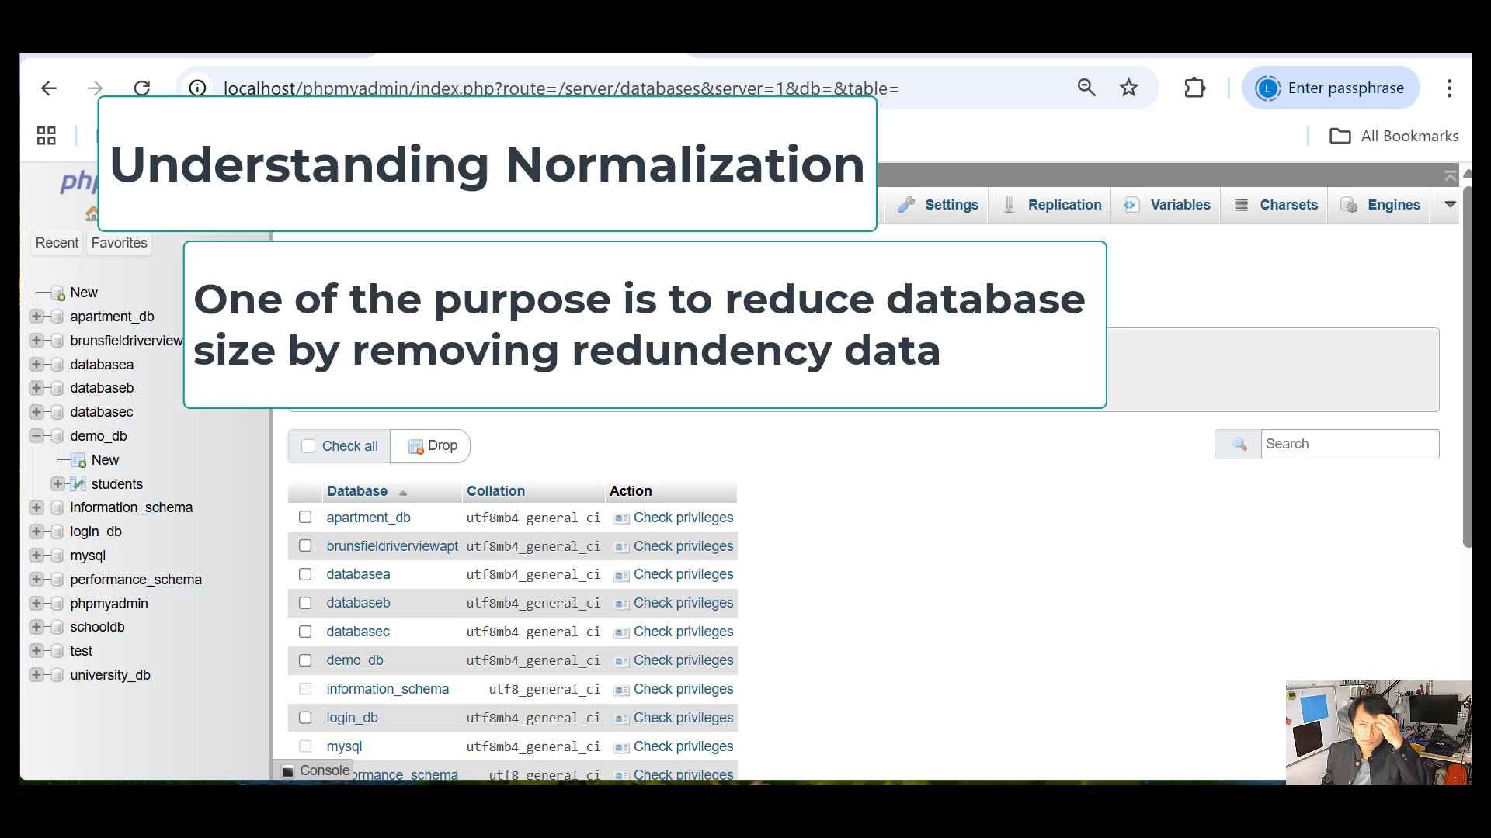
DEMO: NORMALIZATION

Slide 7
STRUCTURED DATA
• Data that is organized in rows and columns.
• Easily searchable in relational databases.
• Examples: spreadsheets, SQL databases.

Slide 8
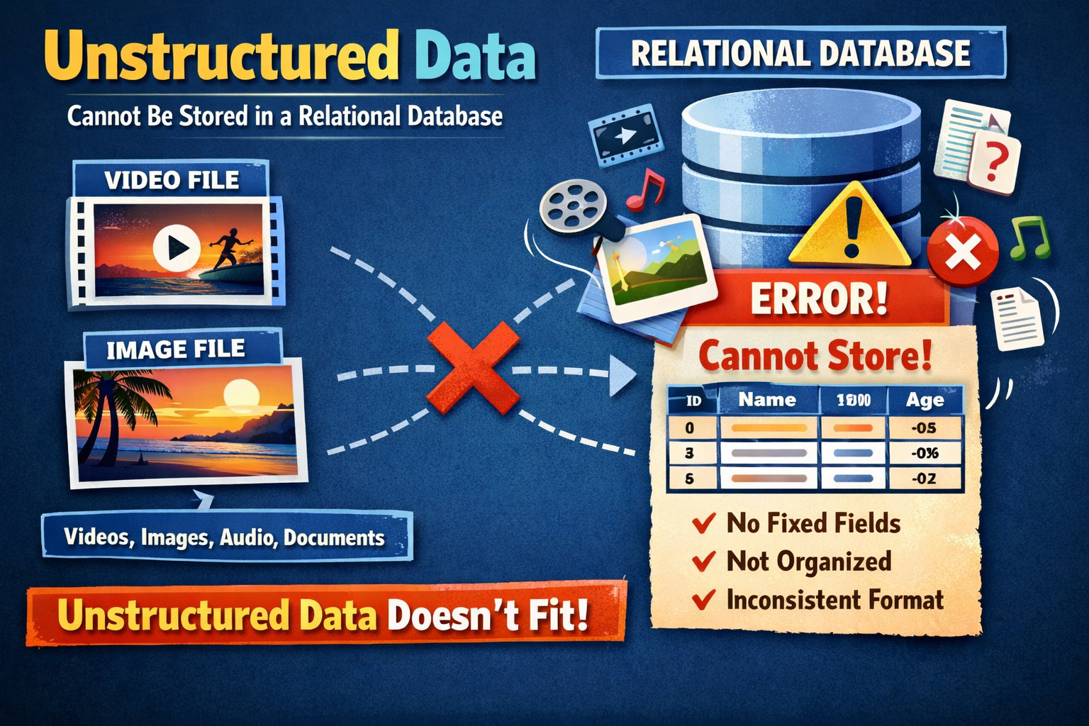
UNSTRUCTURED DATA
• Data not organized in rows or columns.
• Difficult to search or analyze.
• Examples: images, videos, text files.

Slide 9
STRUCTURED VS UNSTRUCTURED DATA
• Structured Data:
- Easy to search, store, and process.
- Uses relational databases.
• Unstructured Data:
- Requires more complex processing.
- Often stored in non-relational databases.

Slide 10
FILE FORMATS OVERVIEW
• Text Files: .txt, .csv
• Image Files: .jpg, .png
• Audio/Video Files: .mp3, .mp4
• Document Files: .pdf, .docx

Slide 11

MARKUP LANGUAGES OVERVIEW
HTML: Hypertext Markup Language
XML: Extensible Markup Language
Markdown: Lightweight markup for formatting text

