Slide 1
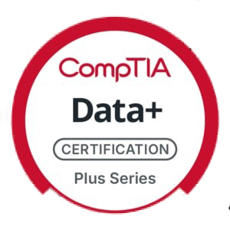
CompTIA Data+ (DA0-001) Exam:
Data+ V2 (New Version)
Introduction & Data Concepts
Overview of Exam Structure and Objectives
Intro to Data Schemas, Environments, and Types

Slide 2
COMPTIA DATA+ (DA0-001) EXAM STRUCTURE AND OBJECTIVES
Exam Code: DA0-001
Number of Questions: Approximately 60 questions
Duration: 90 minutes
Passing Score: 700/900
Question: Multiple choice and performance-based
Objectives:
  1. Data Concepts and Environments
  2. Data Collection, Data Analysis, and Reporting
  3. Data Governance, Quality, and Security

Slide 3
PERCENTAGE
DOMAIN | PERCENTAGE OF EXAMINATION
1.0 Data Concepts and Environments | 15%
2.0 Data Mining | 25%
3.0 Data Analysis | 23%
4.0 Visualization | 23%
5.0 Data Governance, Quality, and Controls | 14%
TOTAL | 100%

Slide 4
NEW SYLLABUS
Data concepts and environments (20%)
Explain data concepts: Database types, data structures, file extensions, and data types.
Identify data sources: Databases, APIs, website data, files, logs and repositories.
Recognize infrastructure concepts: Cloud, on-premise, storage, and containerization.
Identify data tools: Coding environments, BI software, and analysis platforms.
Understand AI concepts: Identify AI models, natural language processing, and robotic automation.

Slide 5


Slide 6
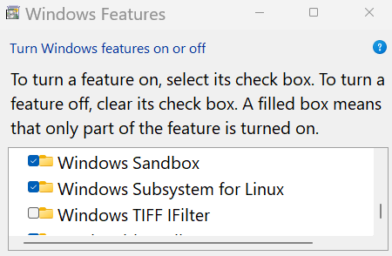
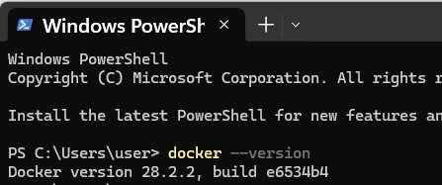
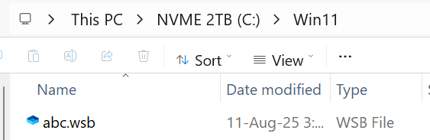
DEMO: CONTAINERIZATION
Notes:
Check hypervisor status: bcdedit
bcdedit /set hypervisorlaunchtype off
Check docker version: docker –version or docker version
Verify docker properly installed : docker run hello-world

Slide 7
NEW SYLLABUS
Data acquisition and preparation (22%)
Use data acquisition methods: Data integration and queries to gather and combine data.
Perform data exploration: Find missing values, duplication, redundancy, or outliers.
Apply data transformation: Cleansing, merging, parsing, and formatting data.

Slide 8
NEW SYLLABUS
Data analysis (24%)
Communicate analysis results: Select methods for different audiences.
Select statistical methods: Apply basic statistical techniques to data.
Troubleshoot analysis issues: Use tools and resources to resolve problems.

Slide 9
NEW SYLLABUS
Visualization and reporting (20%)
Create effective visuals: Use charts, maps, tables, and design elements.
Deliver reports: Provide dashboards or summaries using appropriate methods.
Validate reporting accuracy: Apply validation and review to solve reporting issues

Slide 10
NEW SYLLABUS
Data governance (14%)
Explain data management practices: Documentation, versioning, and data lineage.
Summarize compliance requirements: Retention, audits, and regulations.
Compare privacy and protection strategies: Access control, encryption, and masking.
Implement quality assurance: Profiling, monitoring, and testing for data quality.

Slide 11
TOPICS COVERED IN THE DATA+ EXAM (CONTINUED)
Data Types and Structures: Relational and Non-relational databases
Data Processing: Transformation, cleaning, and reporting
Data Governance: Compliance, data security, and privacy
Data Tools: Analysis tools and reporting software

Slide 12
EXAM PREPARATION TIPS
Study the official CompTIA Data+ exam objectives.
Take practice exams to assess readiness.
Focus on data governance, security, and database structures.
Familiarize yourself with relational and non-relational databases.
Review data analysis and reporting techniques.

Slide 13
INTRODUCTION TO DATA SCHEMAS, ENVIRONMENTS, AND TYPES
Data Schema: Defines the structure of data within a database or storage system.
Relational Database: Data stored in tables with predefined relationships.
Non-relational Database: Stores unstructured or semi-structured data, such as JSON, XML.
Notes:
What is JSON?
JSON stands for JavaScript Object Notation.
It’s a lightweight data format used for storing and sharing data between computers, applications, or servers.
Even though it was inspired by JavaScript, JSON can be used with almost all programming languages like Python, Java, C#, PHP, and more.

Slide 14
RELATIONAL DATABASES EXPLAINED
Structure: Organized into tables (rows and columns) with primary and foreign keys.
Examples: MySQL, PostgreSQL, Oracle.
Use Cases: Financial transactions, customer data, and inventory management.

Slide 15
NON-RELATIONAL DATABASES EXPLAINED
Structure: Stores data in flexible formats like JSON, key-value pairs, and graphs.
Examples: MongoDB, Cassandra, CouchDB.
Use Cases: Big data, real-time applications, unstructured data.
Notes:
MongoDB stores data in a format similar to JSON, but not exactly JSON.
It actually uses something called BSON, which stands for Binary JSON
Why MongoDB uses BSON instead of pure JSON? Speed, BSON is faster to read/write because it’s binary

Slide 16
DEMO
To demonstrate how to create and display a non-relational database, we can use MongoDB, a popular document-oriented NoSQL database. MongoDB stores data in flexible, JSON-like documents, rather than in traditional tables as in relational databases.
Notes:
Demo Steps:
We'll use MongoDB to create a simple non-relational database and show how data is stored and retrieved. You can follow these steps using the MongoDB Atlas cloud service (for simplicity) or a local MongoDB installation.

Slide 17
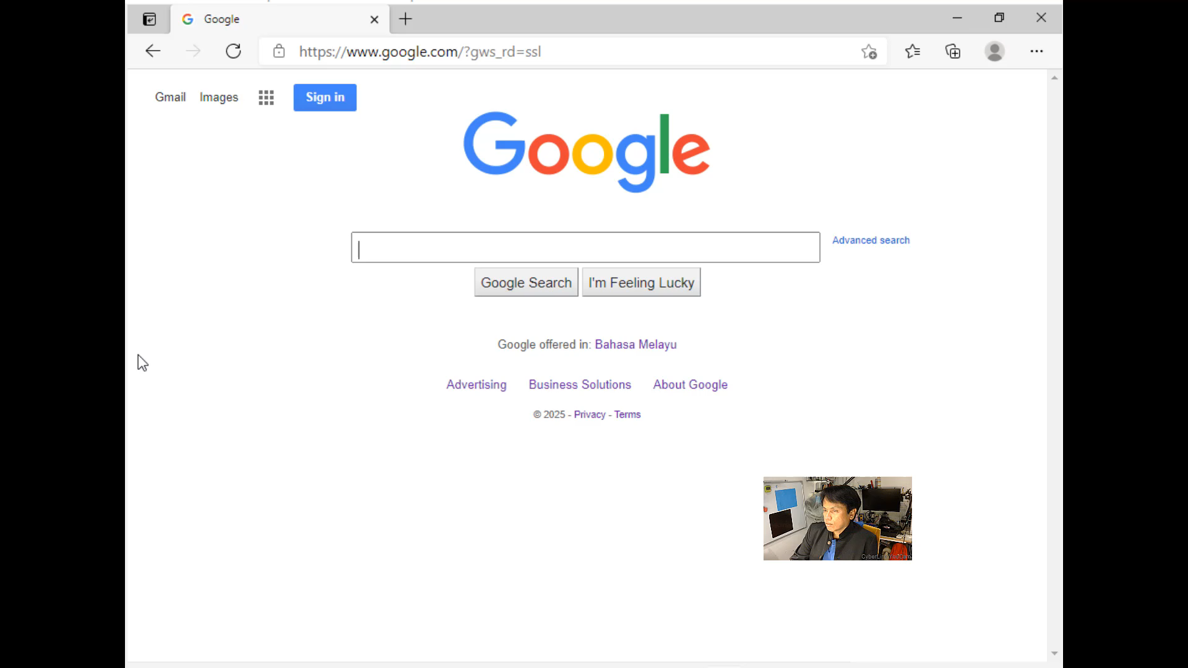
DEMO: MONGODB

Slide 18

DEMO: JSON>Python>JSON

Slide 19
KEY DIFFERENCES: RELATIONAL VS NON-RELATIONAL
Schema: Relational has fixed schema; non-relational is flexible.
Scalability: Non-relational databases scale horizontally; relational scale vertically.
Data Integrity: Relational offers strict consistency; non-relational allows for eventual consistency.

